Slide 1


ErinaOnlineShopping.com
Project Progress

Slide 2







2
business goals
4
Project design
ER
Architecture
Use-case
6
Next Todos
3
Project Management Bricks
1
INTRODUCTION
5
Project progress
7
STC Concepts
5.1. UI Progress:
5.2. Backend Progress:

Slide 3
1. INTRODUCTION
The business objectives for "Erina Online Shopping" company involve showcasing products on their website, allowing customers to easily browse and make purchases. The company also aims to offer a platform for vendors to market and sell their goods through an online-based system. Furthermore, the system is designed to facilitate seamless data exchange between customers and vendors.
Next Slide
By Samrawit

Slide 4
2.Business Goals:
The goal is to develop a user-friendly platform that caters to a global audience, both for customers and vendors. By doing so, the system will not only save time and effort for end-users but also offer a diverse range of products from various brands by establishing strong relationships with vendors and producers worldwide.
Next Slide
By Samrawit

Slide 5
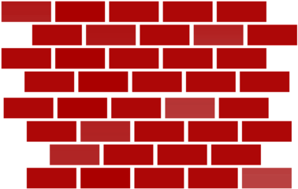
3. Project Management Bricks
The long-walk from scope management to the Risk management…
View Slides

Slide 6








01
SCOPE MANAGEMENT
02
TIME MANAGEMENT
PM
-A function required to ensure that the project includes all the work and the only the work required, to complete the project successfully.
.
Project Time Management is all about ensuring timely completion of the project
PM
03
COST MANAGEMENT
04
QUALITY MANAGEMENT
PM
Describes the process involved in planning, estimating, budgeting, and controlling costs so that the project is completed within budget.
.
.
Ensures software ensures the quality expectations and needs of the clients
PM
05
STAFFING MANAGEMENT
06
COMMUNICATION MANAGEMENT
PM
Human Resources Management includes the processes required to make the most effective use of the people involved with the project.
Describes the process concerning the timely and appropriate generation, collection, dissemination, storage and ultimate disposition of project information IInformation.
PM
07
INTEGRATION MANAGEMENT
08
RISK MANAGEMENT
PM
Project Integration Management is the function required to ensure that the various elements of the project are properly coordinated.
Systematic process of identifying, analyzing, and responding to project risks
PM

Slide 7
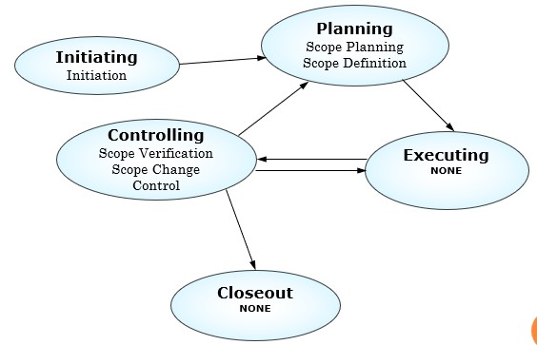
01
SCOP MANAGEMENT
PM
-A function required to ensure that the project includes all the work and the only the work required, to complete the project successfully.
Using historical information, strategic plan and description as input, we used expert judgement and Other project selection methods we have got, a project charter as an output for the next management plans.
View Slides
By Samrawit

Slide 8
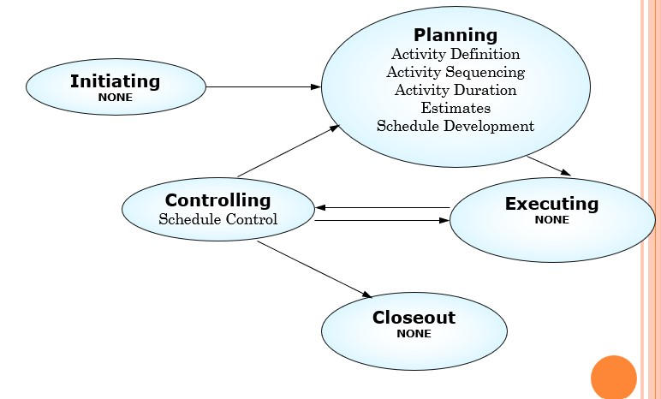
02
TIME MANAGEMENT
Project Time Management is all about ensuring timely completion of the project.
PM
Using quality, scope statement, product description, standards and regulations as input, we used cost-benefit Analysis, Benchmarking, flow-charting, design of experiments and cost of quality methods we got, quality management plan, operational metrics, checklists as input to the next processes.
View Slides
By Weini

Slide 9
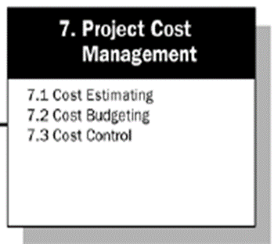
03
COST MANAGEMENT
PM
Describes the process involved in planning, estimating, budgeting, and controlling costs so that the project is completed within budget.
Estimate H/W and S/W components
Project Manager, Team and Procurement Department.
Provide the reports of EVM to the cost control team for further budgeting and approval on the project.
PM, Procurement Manager, Steering Committee In-charge and Cost Control Lead.
Estimate Man days, LOC (Classes, Batch codes and any other coding to integrate the system). Use proper Cost Control Techniques to estimate individual item in each category.
Miscellaneous Cost estimation for Project Execution (IS, Petty items, Travel costs, External Vendor Consultancy, Stationary, etc.)
Project Steering Committee and Project Management Committee
Project Management Team and Architects
View Slides
By Mussie

Slide 10
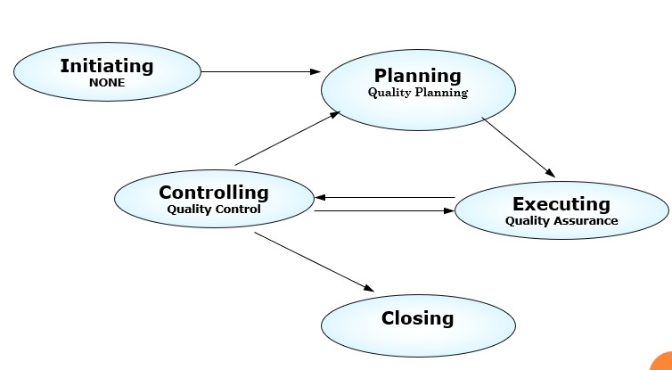
04
QUALITY MANAGEMENT
PM
Ensures software ensures the quality expectations and needs of the clients
Using activity list, constraints, resource requirement and Historical information as input, we used expert judgement, analogues estimating and simulation methods we got, Activity Duration Estimates, Basis of Estimate and Activity List Update for the next management plans.
View Slides
By Frehiwet

Slide 11
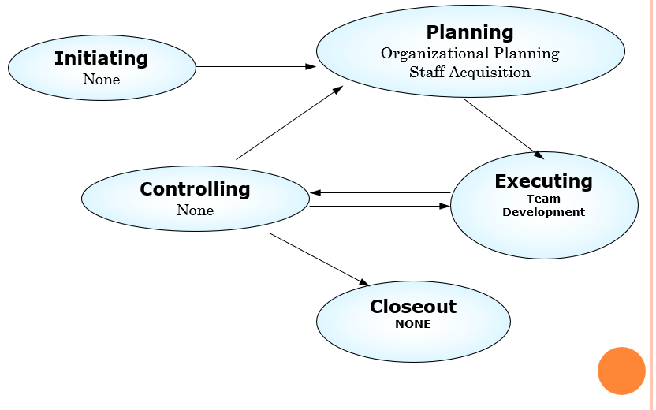
05
STAFFING MANAGEMENT
Project Human Resources Management includes the processes required to make the most effective use of the people involved with the project.
PM
Using Project Interfaces, Staffing Requirement and Organizational Policies as input, by using Human Resource Practices, Organizational Theory and Stakeholder Analysis techniques. we get Roles and Responsibility Assignment, Staffing Management Plan, Organization Chart and Supporting Details for the next project plans.
View Slides
By Tsinat

Slide 12
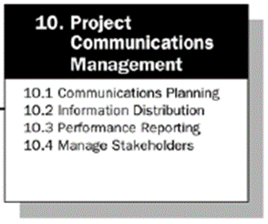
06
COMMUNICATION MANAGEMENT
PM
Describes the process concerning the timely and appropriate generation, collection, dissemination, storage and ultimate disposition of project information.
Plan all the SDLC Phases, UAT Plan, Implementation Plan and Handover Plan
Project Manager, Team Leads and the team members. Client Manager is also part of this Task.
Conduct periodical Steering Committee Meetings, Project Management Meetings and Project Team Meetings. Plan the dates well in advance and make them part of the schedule.
Project Manager, Client Manager and Steering Committee in-charge.
Keep updating all the stake holders on the status of the projects. Keep updating the Show Stoppers in advance to the stake holders.
Generate the Project Daily, Weekly, Fortnight, and Monthly reports. Keep track of the EVM and the Project Schedules. Generate the Risk Reports and update the Stake Holders.
Client Manager, Project Manager, Team Leads. Steering Committee is also part of this Plan.
Project Manager, Team Leads, Team Members and the Client Manager
View Slides
By Haile

Slide 13
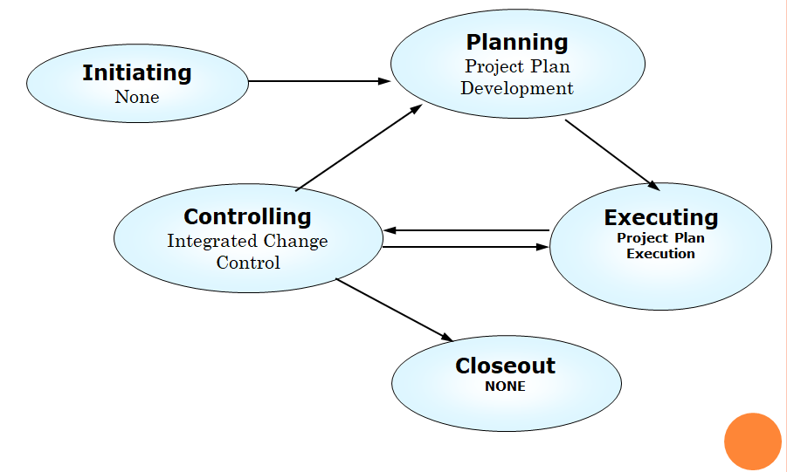
07
INTEGRATION MANAGEMENT
PM
Project Integration Management is the function required to ensure that the various elements of the project are properly coordinated.
Using Project Plan, Performance reports and Change requests as input, we used Change Control Systems, Configuration Management, Performance Measurement, Additional planning and PM Information System techniques we got, Project Plan updates, Corrective action and Lessons Learned for the next management plans.
View Slides
By Keletazghi

Slide 14
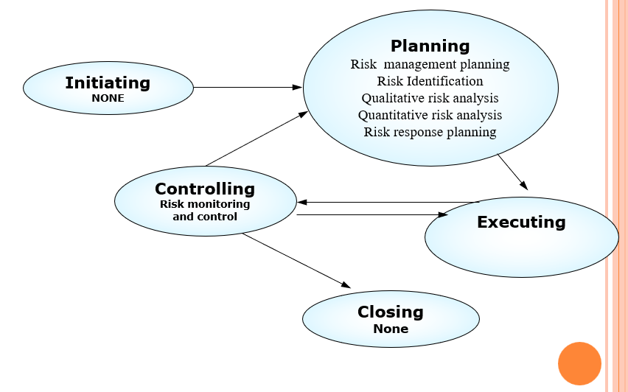
08
RISK MANAGEMENT
PM
Systematic process of identifying, analyzing, and responding to project risks
Using Project charter, Defined roles and responsibilities, Stake holders risk tolerances, management plan and Work breakdown structure(WBS) as input, we used planning meetings methods we have got our Risk Management plan for the next project plans.
View Slides
By Yodit

Slide 15

4. Project Design:
ER Diagram
Architecture Design
Use-Case Diagram
Technologies used
View Slides

Slide 16
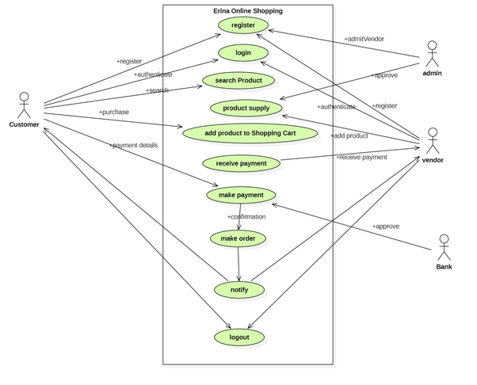
Erina Online Shopping Use-case Diagram:
By Keletazghi

Slide 17
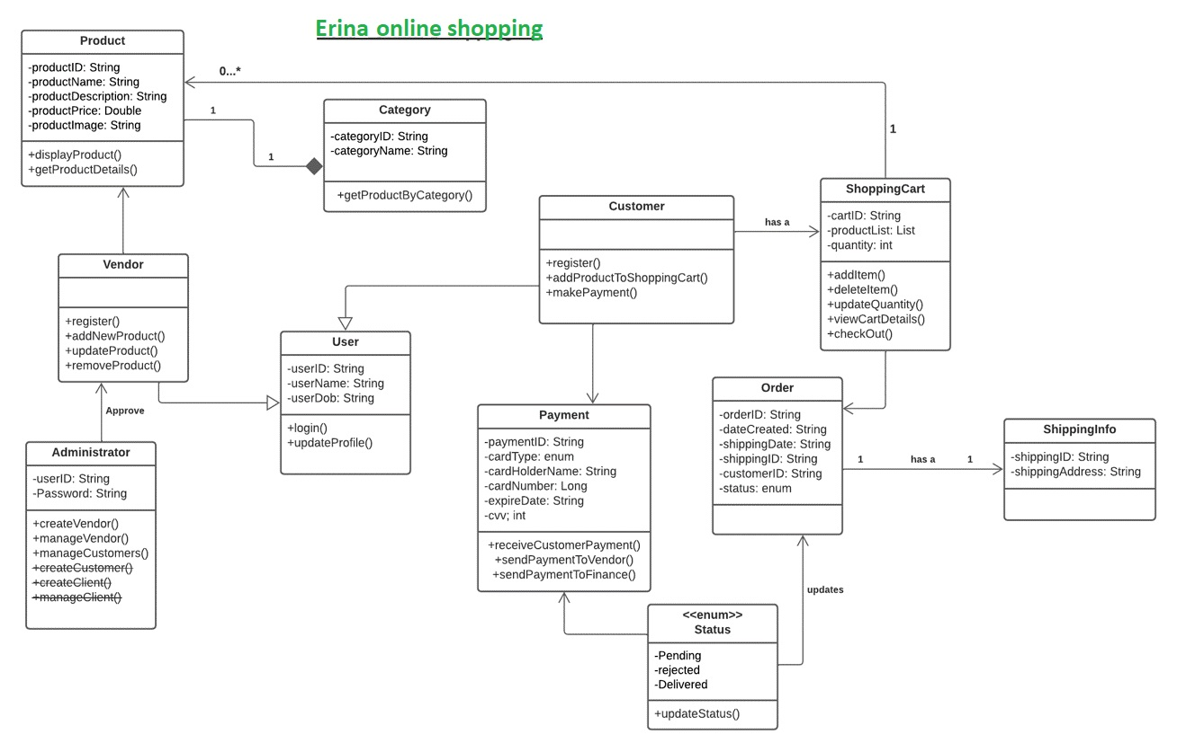
Erina Online Shopping ER Diagram:
By: Mussie

Slide 18
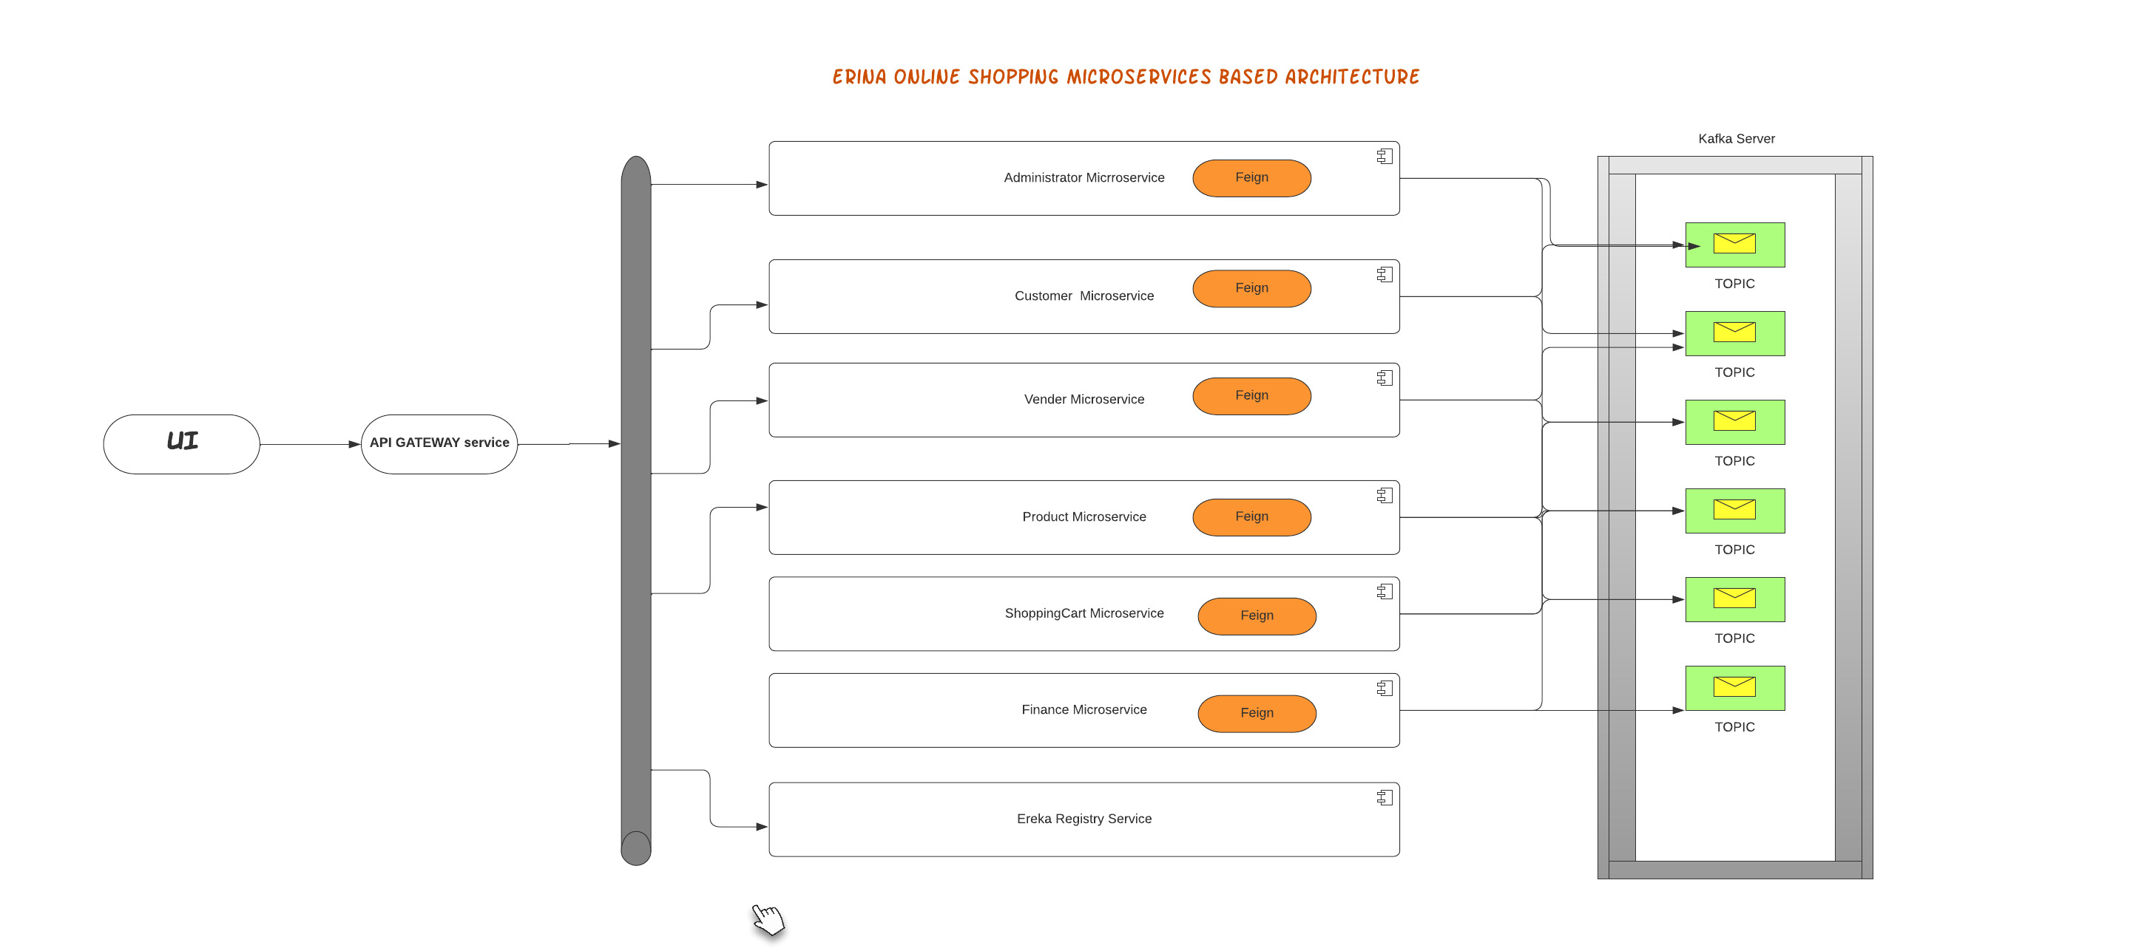
Erina Online Shopping Architecture Diagram:
By: Haile

Slide 19
TECHNLOGIES USED IN ERINA ONLINE SHOPPING DEVELOPMENT:
Architecture:
Backend:
Order Management Module
User Registration Module
Administration module
Security Module
Payment Module (Tentative)*
Reports Module
Finance Module
Frontend: Angular
Languages:
Java,
Angular and Angular material for the UI,
Spring (Security, IOC, and Data),
Hibernate,
MongoDB,
Java / Spring boot,
CSS3, HTML5,
JavaScript and typescript,
Restful / JSON,
SMTP/ JMS/Kafka
Docker,
GitHub,
AWS
By: Haile

Slide 20




5. PROJECT PROGRESS DETAILS
FOLLOWING WE WILL SEE TWO TYPES OF PRJECT PROGRESS DETAILS:
Project progress modules wise
Project over-all progress to completion
View Slides

Slide 21
FRONTEND PROGRESS
80%
UI Progress:
UI
Preparation of UI project structure and install dependencies
* Define the structure of UI, install all the necessary dependencies needed
Create Components, Services, modules, and files generation
Implementation on shared module
* import all the necessary modules
Implementation of the app component
*Prepare app component using Angular material
Create models
* Prepared classes data before the implementation in all models
Create Authentication service
*Implementation of authentication service, Implement tokens and error interceptors
Implementation of cart service
By: Mussie

Slide 22
BACKEND PROGRESS
01
95%
VENDER SERVICE
Completed tasks in the Vender module: * Vendor user can now signup(register) or sign in (login) with username and password. * Vendor can update his/her profile and his products * Vendor can now add the product * Can now remove the product * Receive the payment through his account.
Created the following end-points
02
By: Keletazghi
Methods | URL | Actions
POST | /api/v1/registor | Signup/has new account
PUT | /api/v1/{vendor id} | Profile updated
POST | /api/v1/addproduct | Product added
GET | /api/v1/product | retrieve all product
DELETE | /api/v1/product/{productid} | User Can Cancel his product
03
04

Slide 23
85%
Shopping Cart Service
02
01
Tasks completed:
Product import and Export
Product Update, Reviews
Apply Discount or Coupons
Single Page, Fast Check out
Product import and Export
Product Update
Single Page, Fast Checkout
Next steps to be completed in this module:
Kafka Streaming, creating topic for pub-sub
Integration with Order & Payment Services
02
03
By: Tsinat

Slide 24
95%
ORDER SERVICE
03
Create sender service (using Kafka Template) to send shopping cart data (topic) to order for checkout
create @KafkaListener in the order service to capture the topics
use declarative REST Client @FeignClient to get Customer Details
create the order based on the captured topics and persist to database
02
By: Frehiwet
100%
Registry and API Gateway
04
Client apps use a single endpoint or URL, which the gateway then translates to a set of internal microservices
Each Microservice will register with Eureka, and Eureka will be aware of all client apps operating on each port and IP address
When a new service is launched, as well as when a service is taken offline or unavailable, the service registration must be updated
.
04
By: Weini

Slide 25






5.2 Overall Project Progress
75%
COMPLETED
Stage 1
Stage 2
Stage 3
Stage 4
Stage 5
Planning:
Business requirements are compiled and analyzed by a business analyst, domain expert, and project manager.
Designing:
lead developers and technical architects create the initial high-level design plan for the software and system
Developing:
Actual coding happens with selected technology suitable for the domain
Testing:
All sorts of software testing happen to overtaken in this stage.
Maintenance:
After deployment to production is ensure for the continuous functionality of the software
By: Haile

Slide 26
6 Project Next Todos:
Finalizing the unfinished modules of the project
Report service(tentative)
Finalizing Payment Service
Work on end point role-based Security.
Finalizing Work on Service-Messaging using Kafka
Creating all Topics for Pub-Sub
Finalize the Frontend and backend Integration.
Optimize endpoints and Post-Man testing.
Creating the Testing cases for all end-points
By: Mussie

Slide 27
7 SCIENCE OF TECHNLOLOGY AND CONSCIOUSNESS:
“Enjoy greater Efficiency and Accomplish More”
One of the principle of SCI says
Enjoy Greater Efficiency and Accomplish more. Efficiency means the tendency of working well without wasting time, money and resources. It is also the ability to get the most output from the least possible input. It means doing more with less, when you improve efficiency, you're able to get a larger output from the same amount of input or even less this means being able to get more.
In project management, efficiency is its main character. since project management prioritizes thinking and applies the knowledge ,skill, tools and techniques to ensure the project meets its stated goal.so efficiency is important considerations to avoid wasting material, energy, effort, money and time in doing something or in producing a desired result.
Finally, the most important thing is time and money, and by shopping online you can also save your both time and money. There fore Efficiency play a vital role. The principals of SCI also connected. which can make our work to be effective and working smarter not harder.
SCI is a useful intervention or tools for achieving better life. so, let's stay connected.
By: Weini

Slide 28
SCIENCE OF TECHNLOLOGY AND CONSCIOUSNESS continues…
“The whole is greater than the sum of its parts”
To build microservices:- we first need to understand a holistic view of our microservices then how they integrate with each other
Microservice based architecture provides better scalability, eliminates technology lock-in and improves fault isolation.
Long-term practice of TM leads to more positive changes, including resilience to stress, lower overall anxiety, and greater life satisfaction.
Life is Found in Layers.
Every Action has a Reaction.
“The True nature of Life is to grow”
By: Weini

Slide 29




Haile-TEAM-IV MEMBERS
FREHIWET
HAILE
WEINI
SAMRAWIT
MUSSIE
KELETAZGHI
YODIT
View Slides
TSINAT

Slide 30


